Slide 2
Building planet scale .NET apps with Azure Cosmos DB
Justine Cocchi

Slide 3
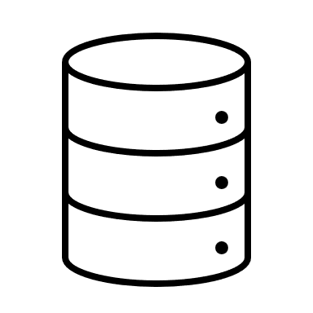
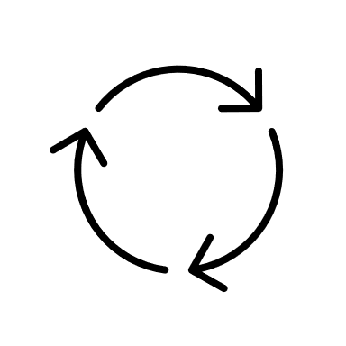

Modern apps have complex data needs
Multiple data sources
Flexible schema
Consistent performance
Notes:
Complex data needs
- Interact with data from multiple sources like events between microservices or user input
- Flexible to schema changes as business requirements evolve
- Consistent performance as the application and database scale
If these problems seem familiar you may be interested in a NoSQL database

Slide 4
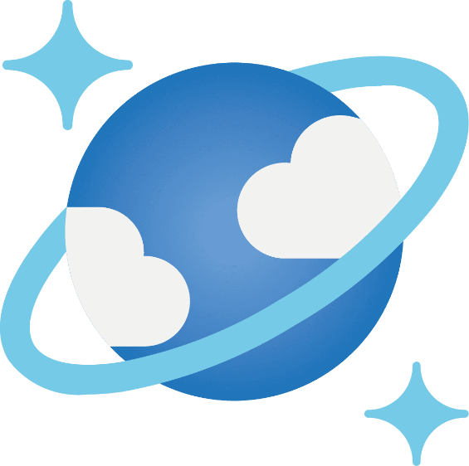
Azure Cosmos DB
Infinite scale out with zero downtime
Constant read/ write latency as you scale
Seamless global distribution
Mission critical security, analytics, Azure integrations and more
Notes:
Azure Cosmos DB is a fast, flexible distributed database with enterprise ready features making it a great choice for many use cases
- Artificial Intelligence, IoT device telemetry, personalization and recommendations etc.
- Used by some of the biggest retailers, gaming platforms, and finance customers
As a distributed database, you can infinitely scale out with zero downtime by either adding data or increasing your Request Units. Request Units are Cosmos DB’s measurement for how much throughput a container can handle- for more throughput scaling up is as easy as one click or one API call. You don't have to make major architecture changes or write complex code to scale your database with Azure Cosmos DB.
Point operations have constant latency as you scale with guaranteed latency and throughput levels.
Global distribution is made easy by seamless replication across regions.
You don’t need to manage complex ETL or data syncing across regions.
You can configure your account to use one write location with multiple read locations or enable multi region writes.
Consistency across regions is maintained with different guarantees depending on what you configure from
Eventual (no order guarantees),
Consistent prefix (no out of order reads),
Session (read your own writes),
Bounded Staleness (reads lag behind K versions or T time), to
Strong (always see most recent version).
Adding multiple regions is recommended for production scenarios to ensure high availability even when one region is unavailable
Mission critical security features such as RBAC authentication, customer managed keys, encryption, network security (vNET, Private Endpoints, Ip Firewall) and more. SLA backed availability and latency guarantees.

Slide 5
Start small and scale up
Develop locally with the emulator
Serverless provisioning for dev/ test workloads
Free tier for getting started
Autoscale throughput when there is workload variability
Notes:
Many cost-effective entry points for either large or small apps. Let’s look at a few ways to provision your account
Local emulator
- Free to download and use
- Supports the API for NoSQL and MongoDB, missing some features like global replication
Serverless
- Available up to 1TB
- Max RUs from 5k to 20k depending on how many physical partitions you have
Free Tier
- One free account per subscription
- First 1K RUs and 25 GB for free for the lifetime of the account
- Can scale beyond that and only pay for the delta
Autoscale throughput
- Great choice for many workloads where there is some variability
- Instant scale from 10% - 100% of your maximum RUs

Slide 6
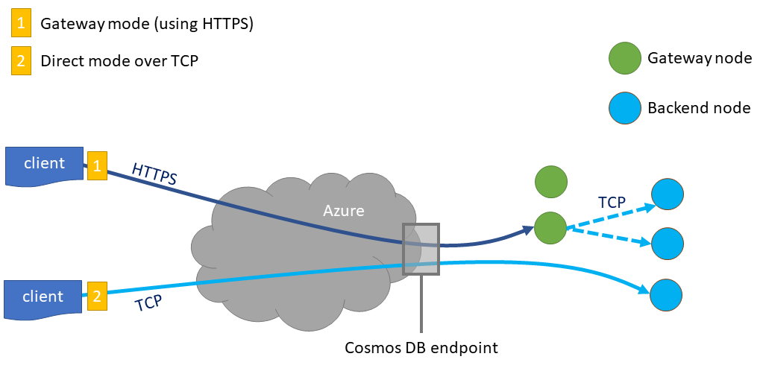
Develop with the .NET SDK
dotnet add package Microsoft.Azure.Cosmos –version 3.36.0
Logical resource model
CosmosClient
Database
Container
Item
Notes:
Frequent version updates, be sure to always use the latest version for the best experience

Slide 7
Let’s get to the demo

Slide 8

Why is monitoring important?
Understand what’s going on under the hood of your app
Easier to…​
Identify high latency requests​
Identify high RU operations​
Identify if a specific application/ machine is erroring more than others
Notes:
Understand what’s going on under the hood of your application
Distributed tracing allows you to understand the end to end request flow and identify any
Open Telemetry

Slide 9
Enter OpenTelemetry

Slide 10
What is OpenTelemetry?
Open-source instrumentation library and standard for observability
Allows for automatic telemetry collection for multiple exporters
Three observability pillars
Distributed tracing
Logging
Metrics
Notes:
Open-source, vendor-agnostic instrumentation library with the ability to send data to multiple exporters through configuration
- consistent APIs/SDKs across languages
Few ways to use this in Azure
- Azure Monitor OpenTelemetry Distro is the best way for ASP.NET applications because it is a thin wrapper over the OpenTelemetry components
- We’re going to show setting it up in a console app so I can walk through the various components
Pillars
- Distributed tracing here refers to tracing all requests made to Cosmos DB
- Logging differs via scenario, for Cosmos DB we added logging for the request diagnostics in exception cases or where latency exceeds a threshold so you don’t need to write any custom code
- Metrics not available yet but would help you get aggregated statics about your requests

Slide 11

Resources
Try Azure Cosmos DB for free aka.ms/TryCosmosDB
Get started with the .NET SDK aka.ms/cosmos-dotnet-get-started
Best practices using the .NET SDK aka.ms/cosmos-dotnet-best-practices
Notes:
Try Azure Cosmos DB free with no credit card required

